Slide 1
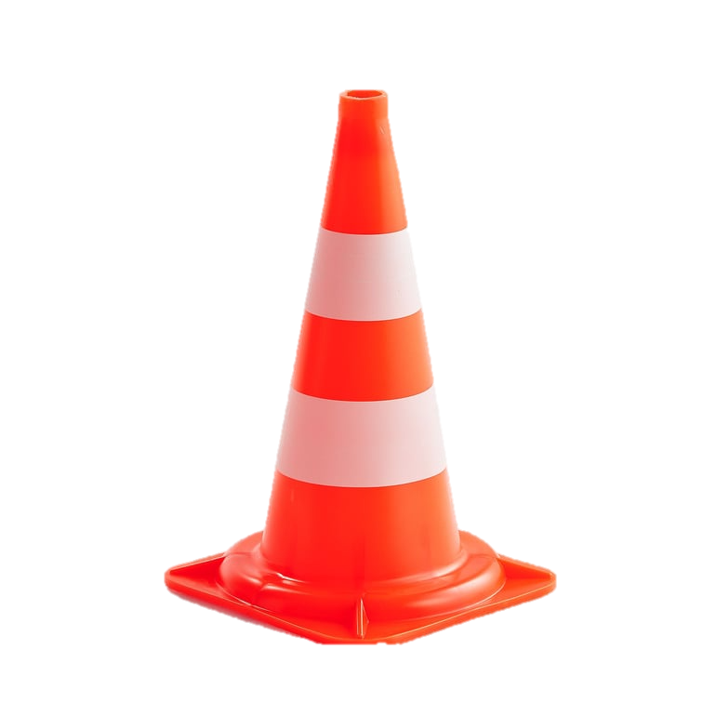
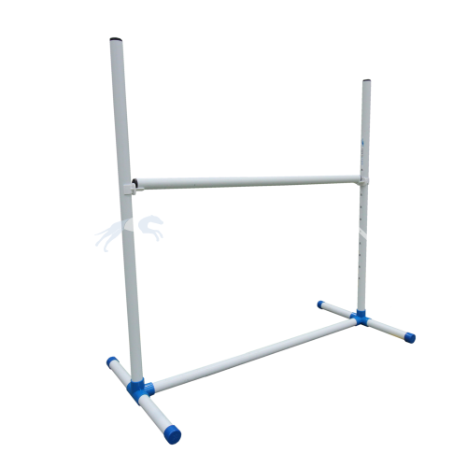
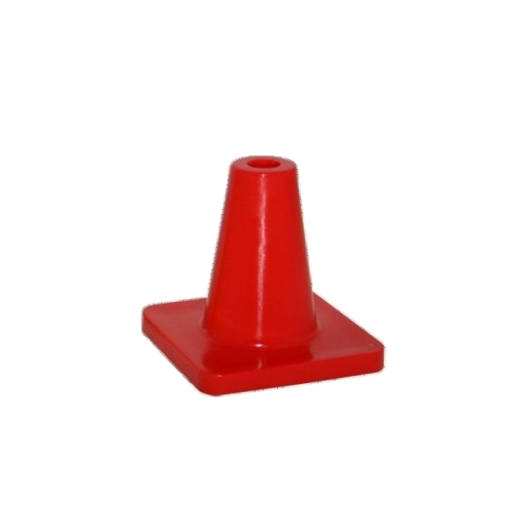
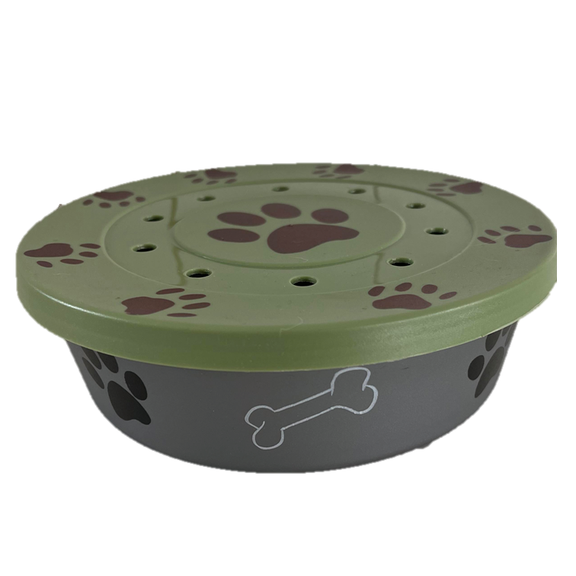
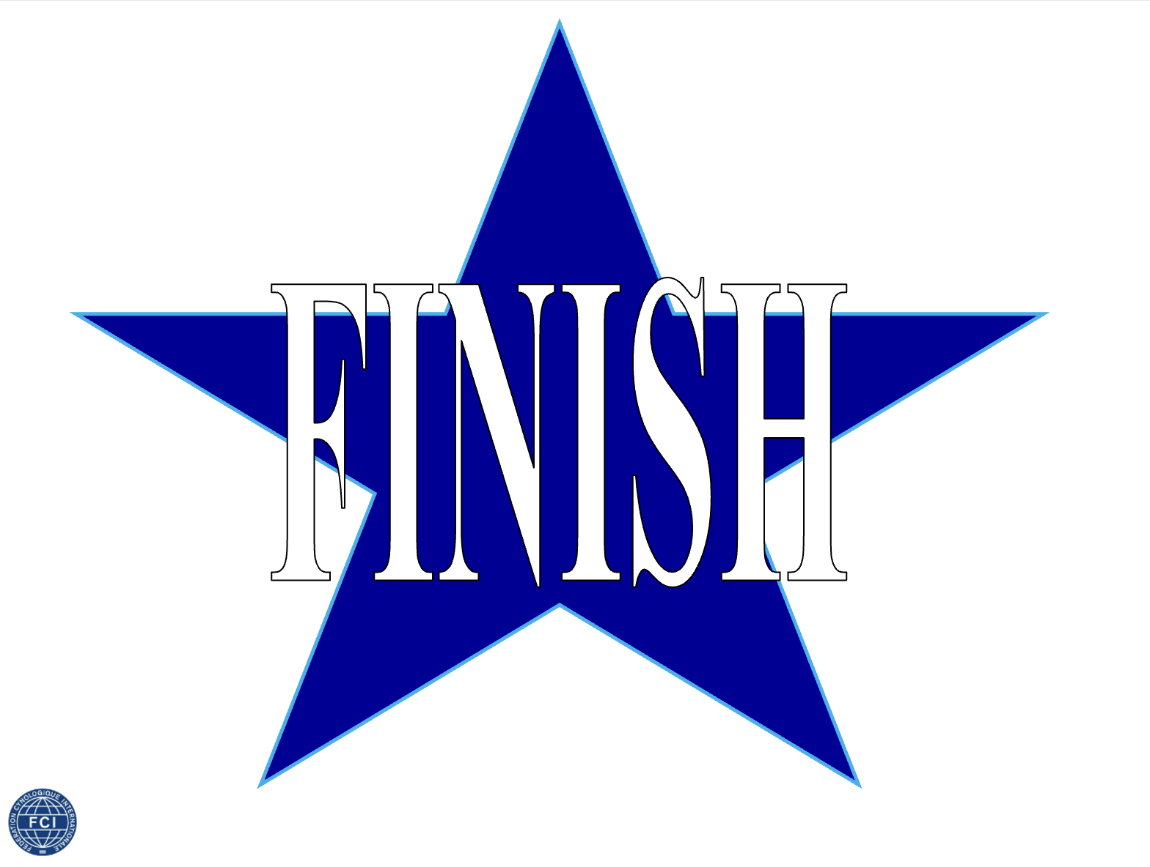
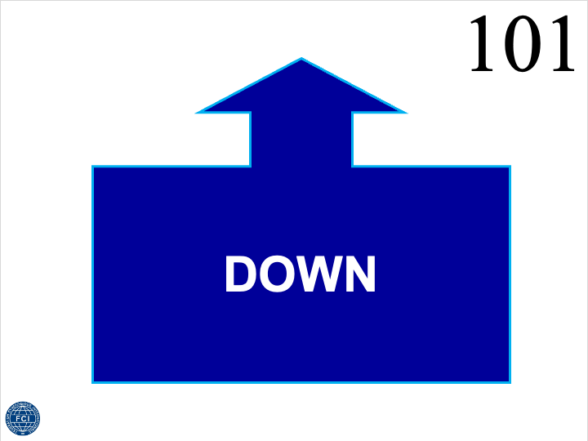
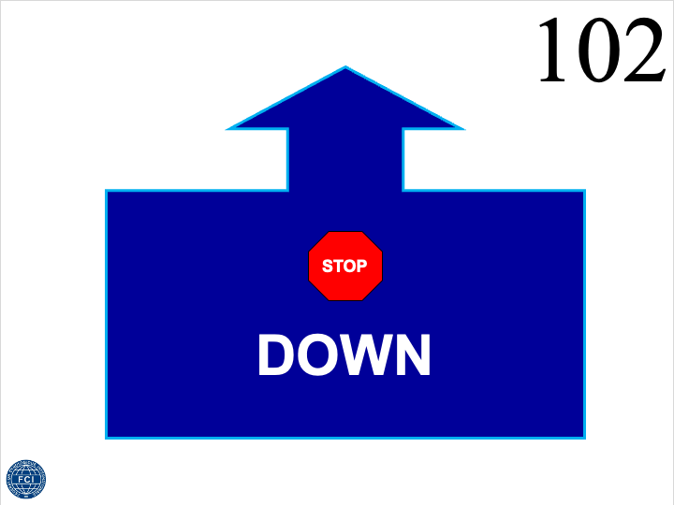
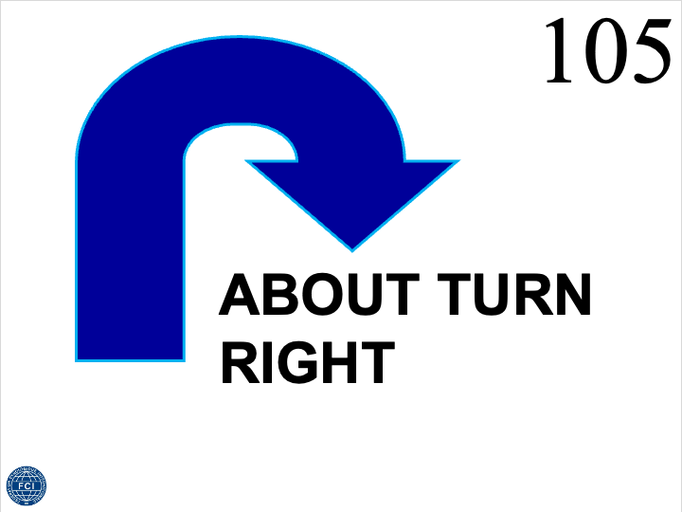
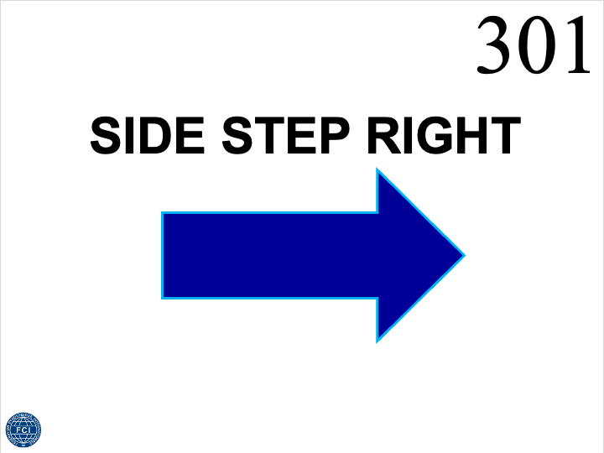
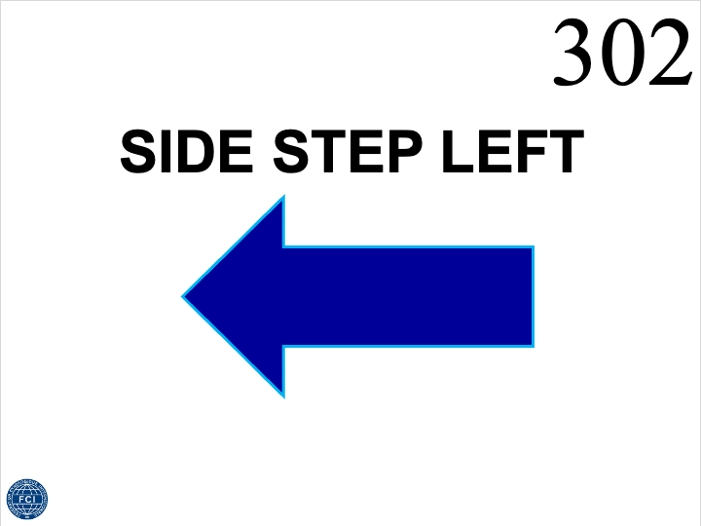
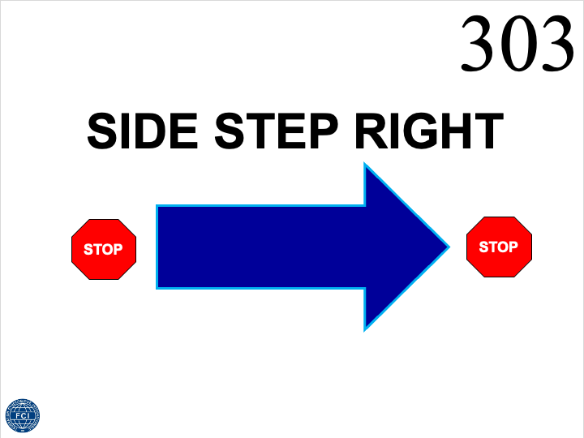
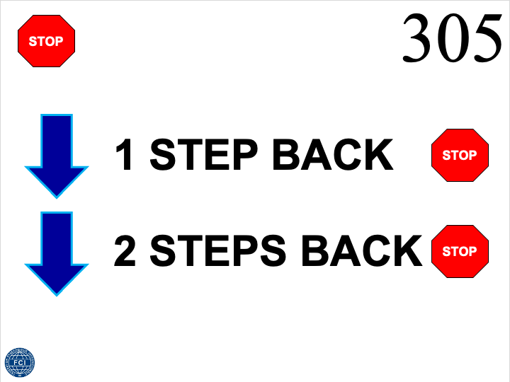
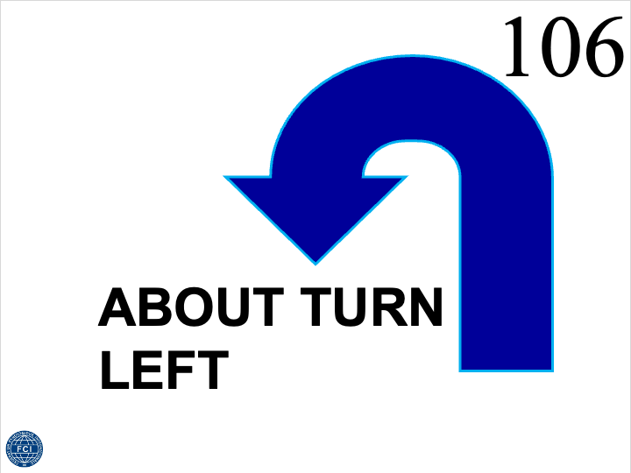
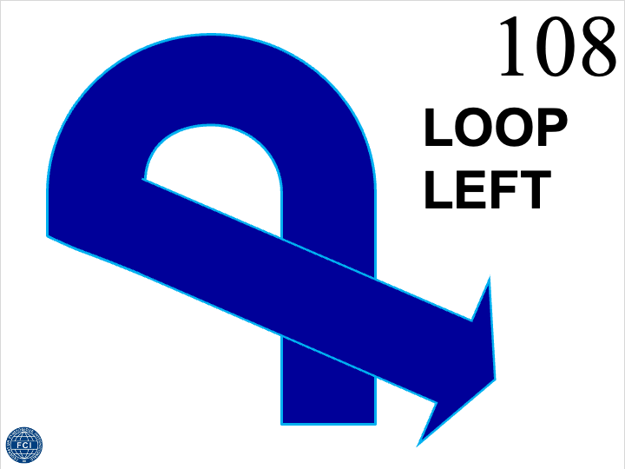
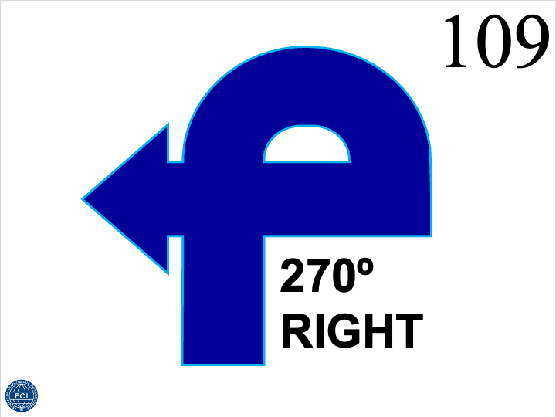
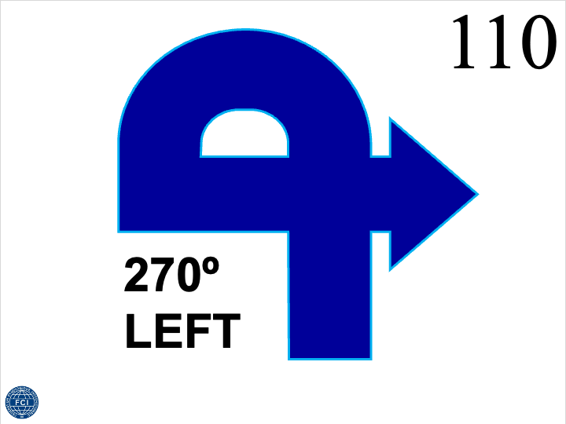
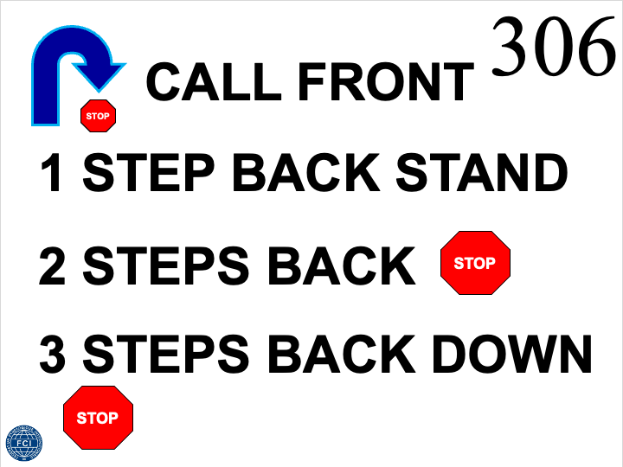
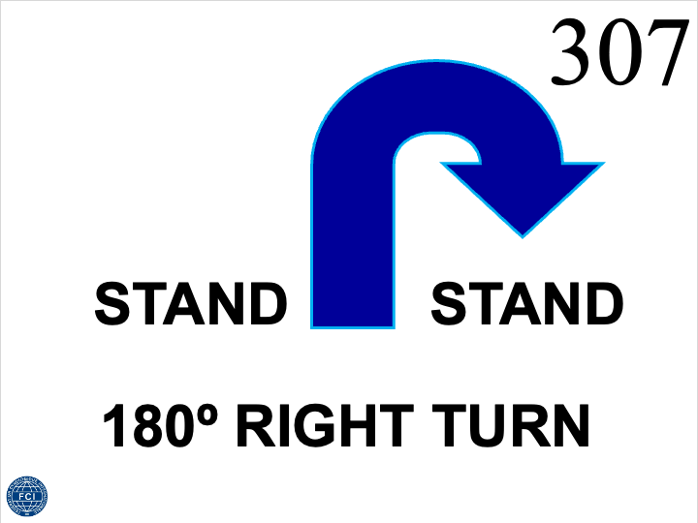
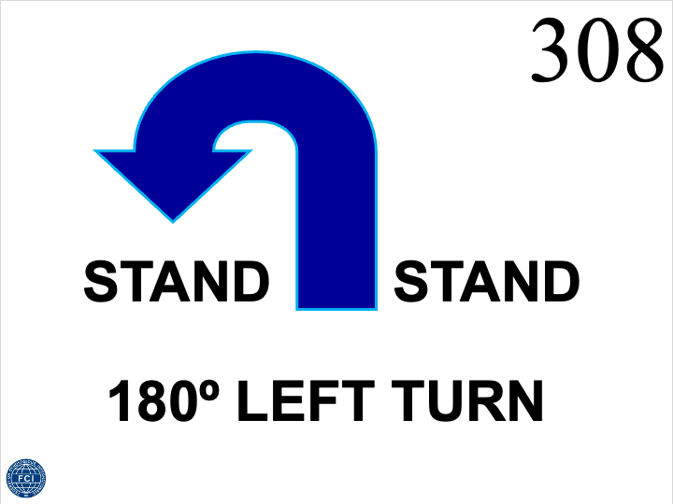
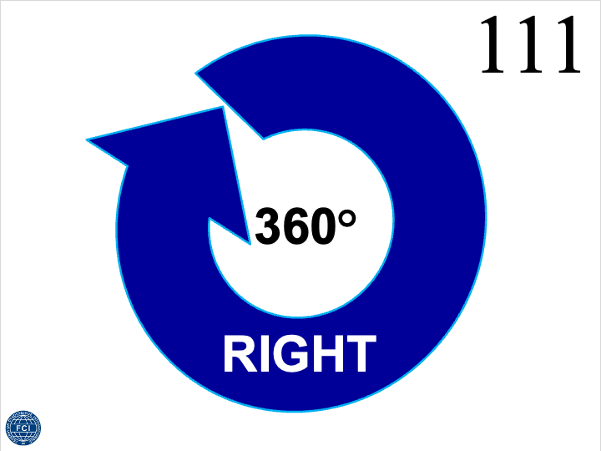
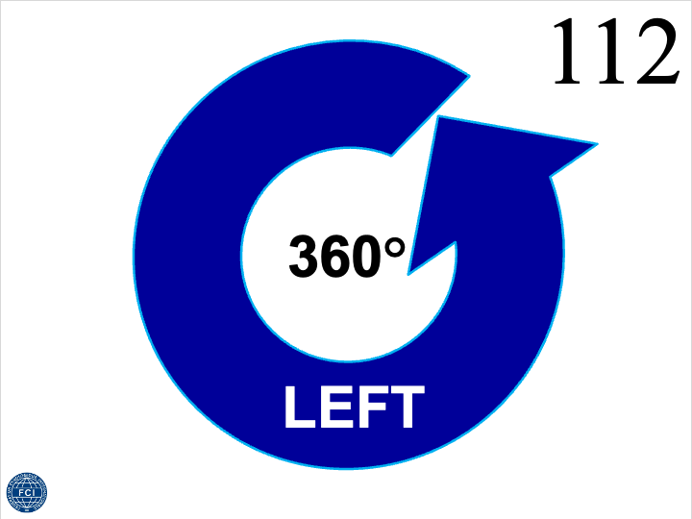
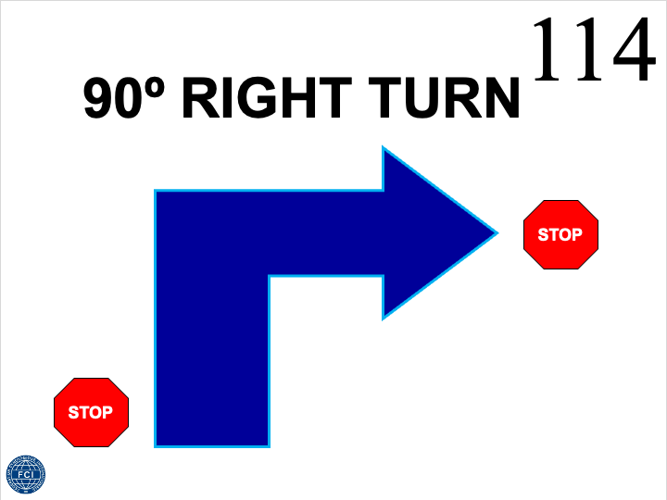
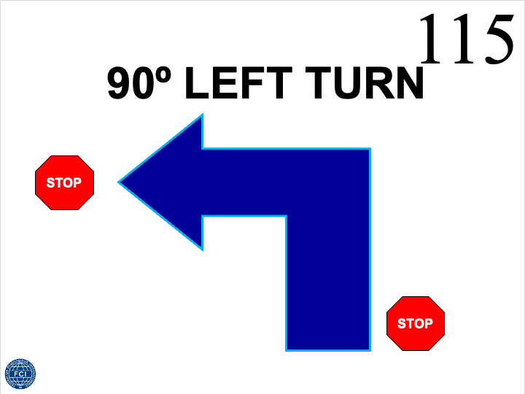
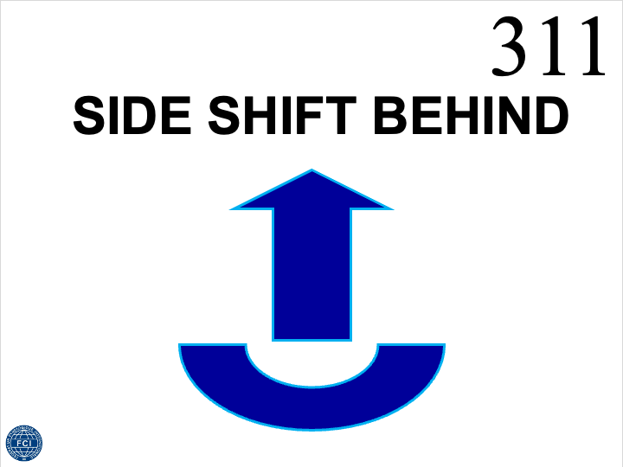
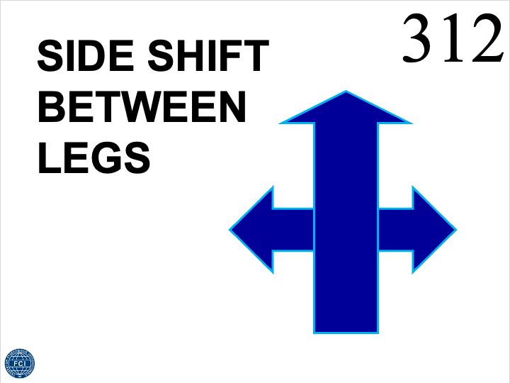
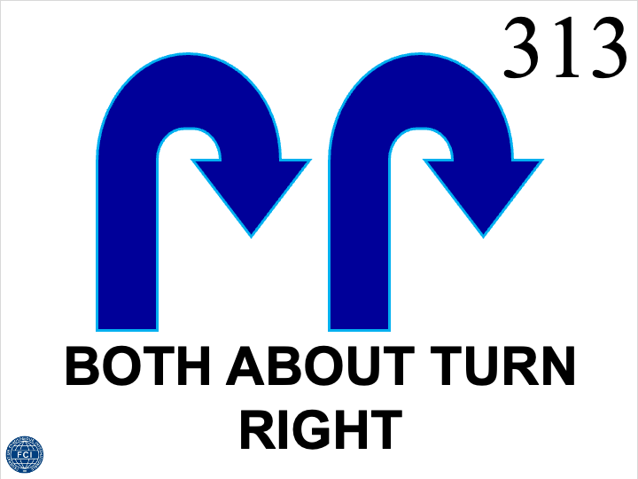
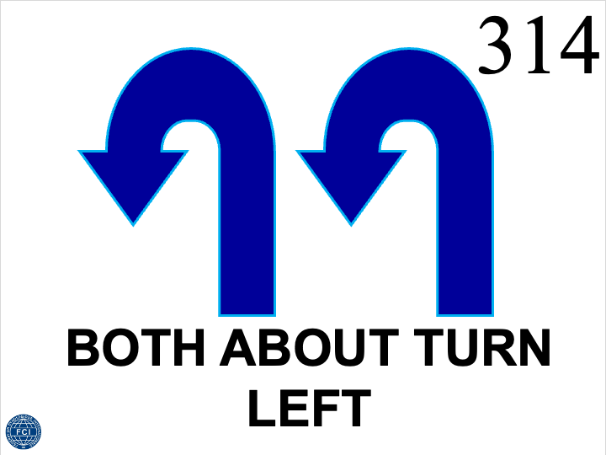
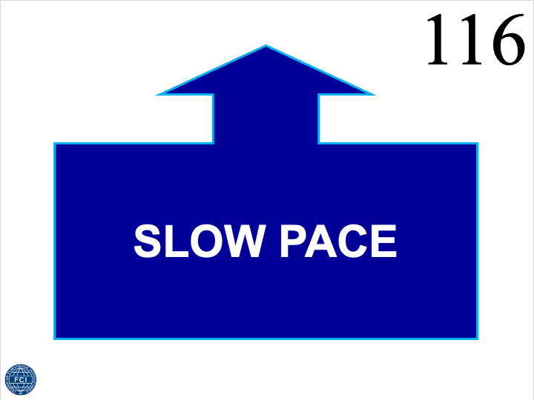
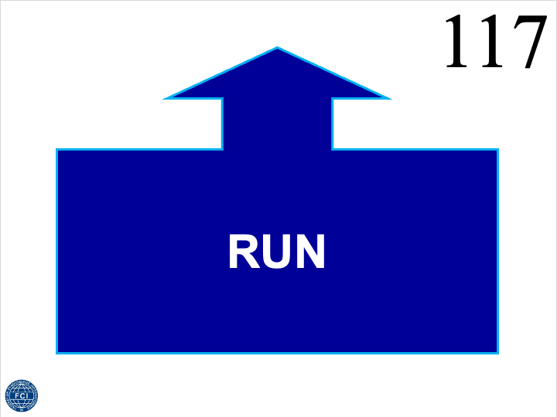
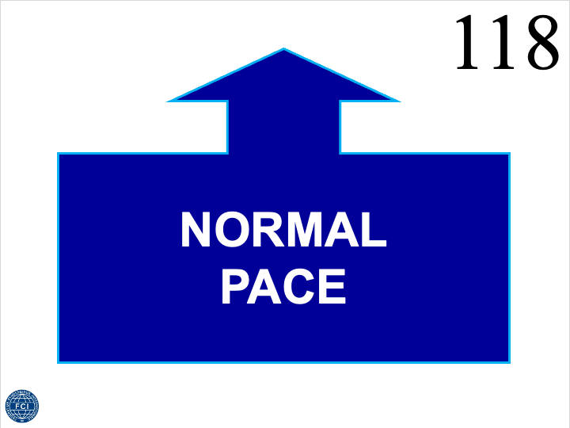
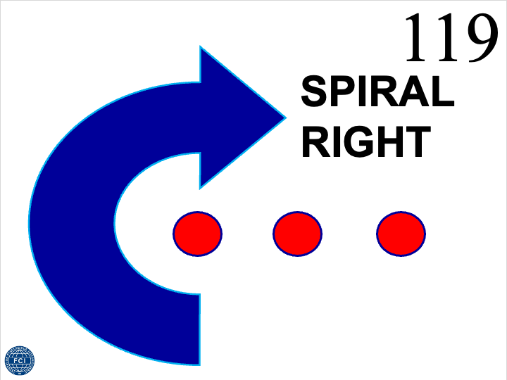
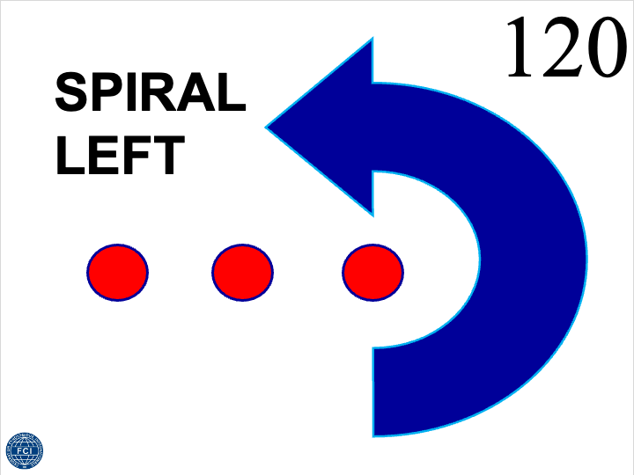
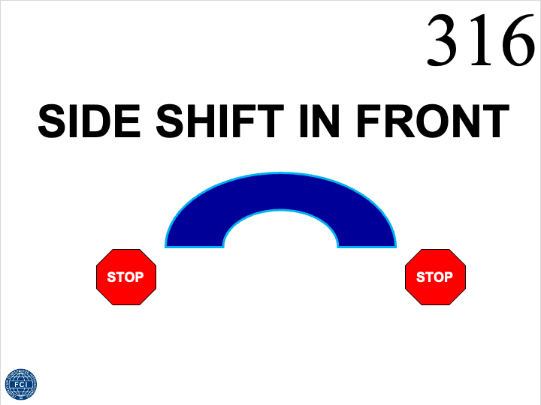
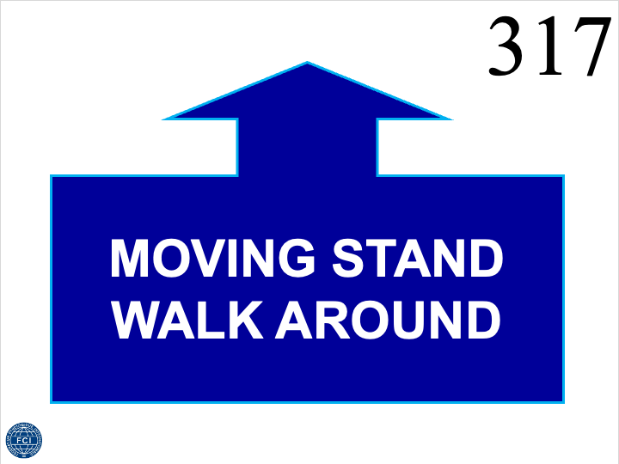
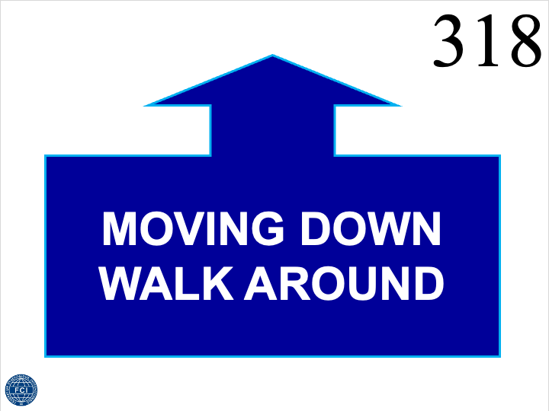
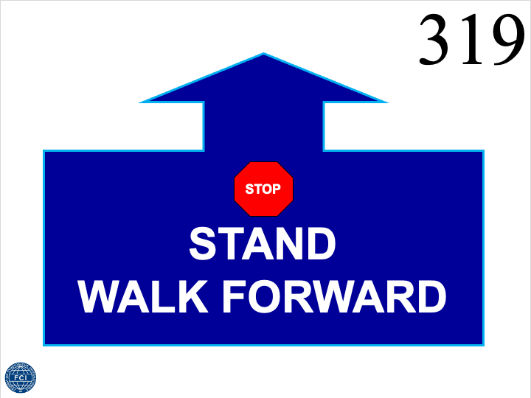
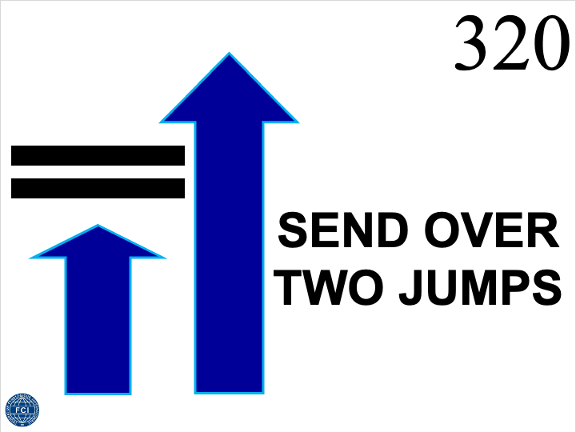
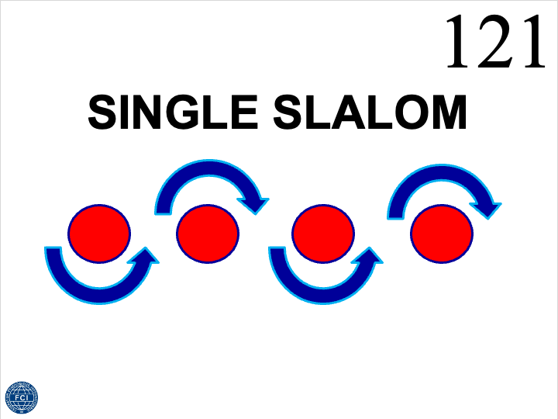
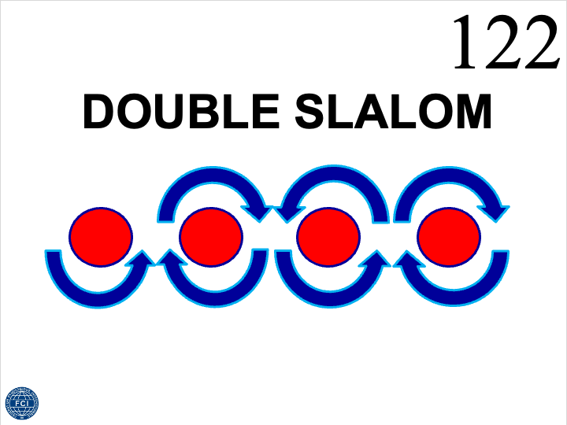
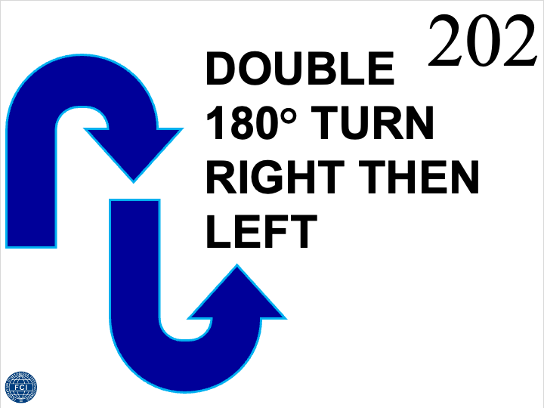
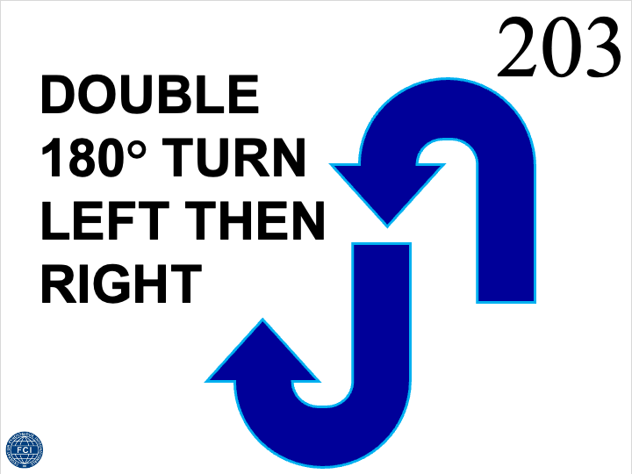
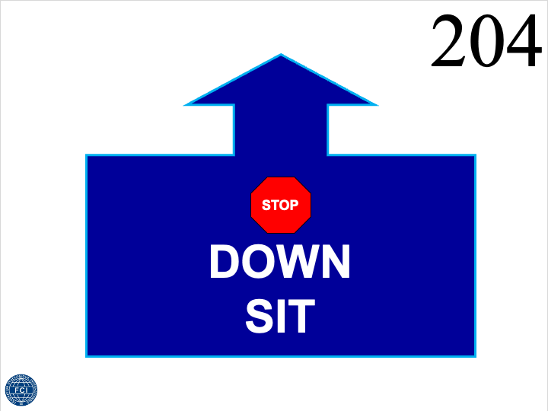
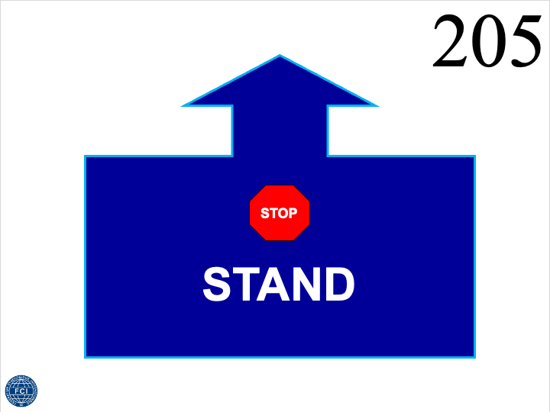
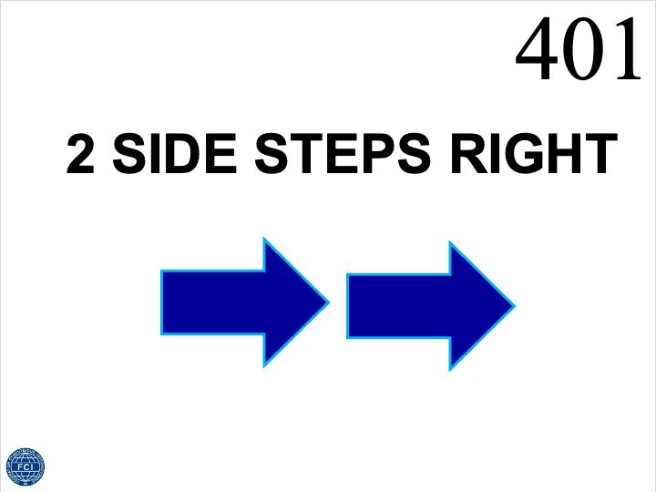
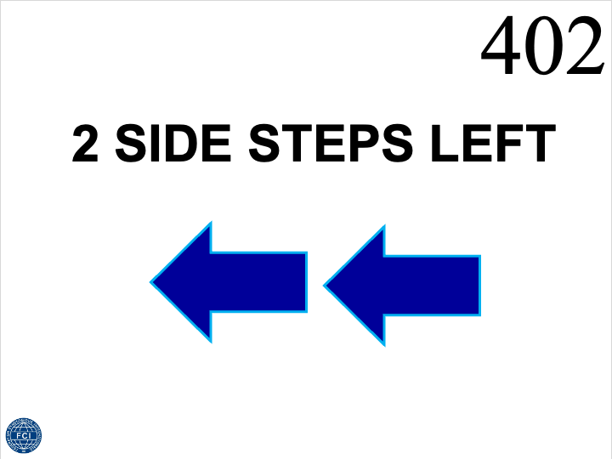
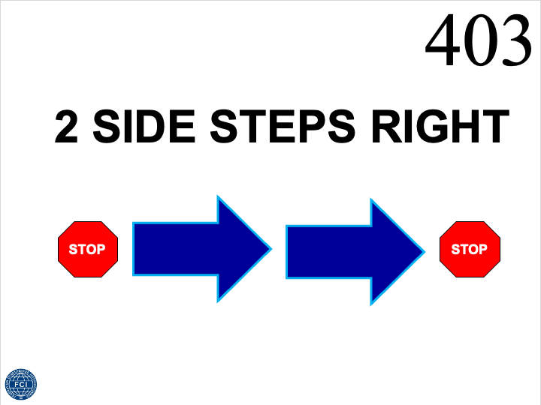
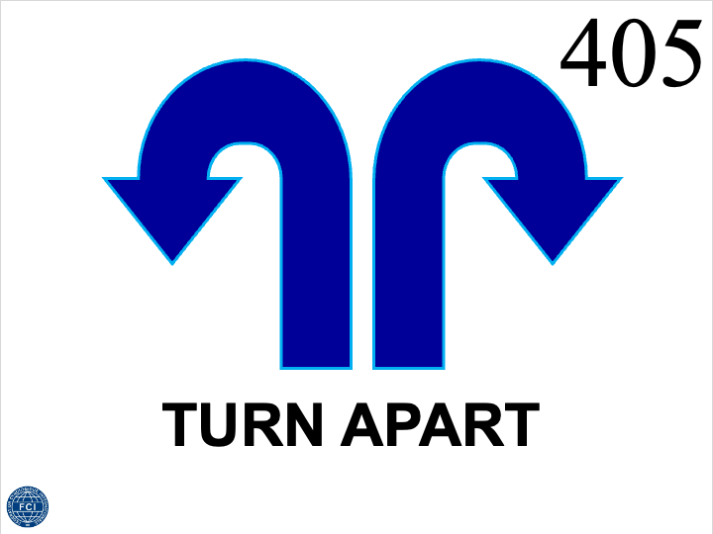
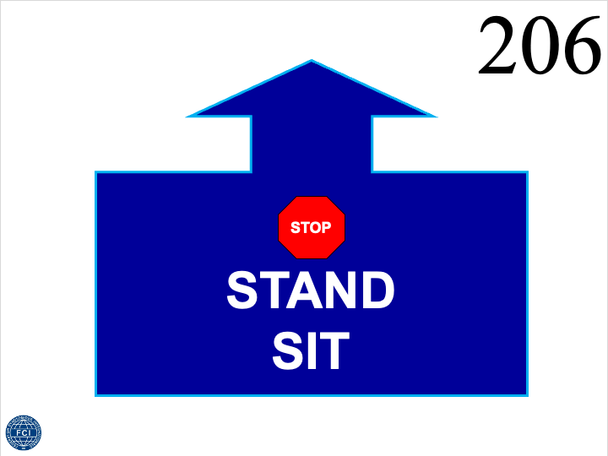
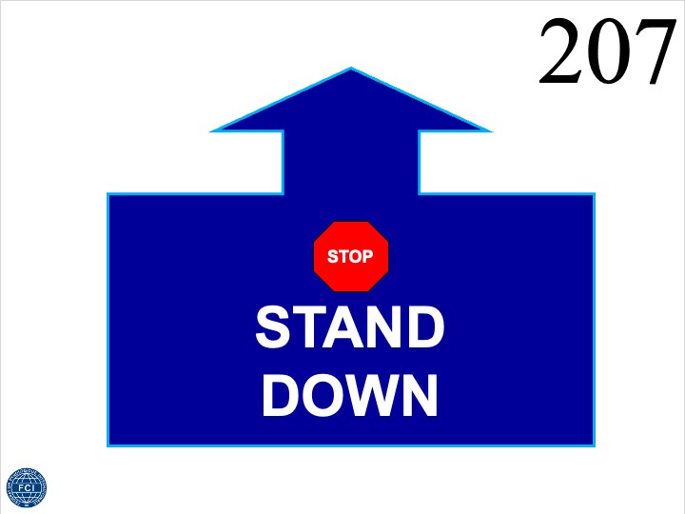
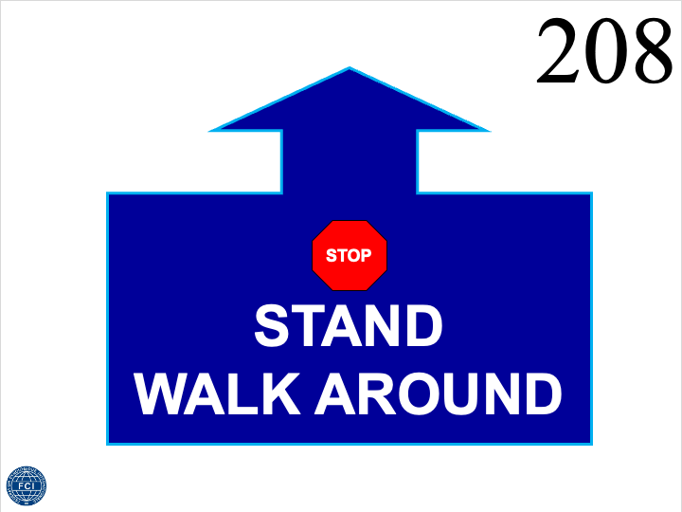
1
2
3
4
5
6
7
8
9
10
11
12
13
14
15
16
17
18
19
20
3.5. Course Layout
The judge has the right to create the course layout of the competition/day/round. If two or more judges are judging one class/round together, one of them will determine the course layout (or every of the judges creates himself a course layout and one will be chosen for example by drawing). The course layout will be posted on the wall of the competition ground at least one hour before the start of the concerning class/round. When designing a course layout judges should focus on a good mix of: • fluent, stopping, position, figure, distance, sending, jumping and recall exercises • left handled and right handled parts If two or more judges are judging together, they should send their course layouts at least one week before the start of the competition to the other judges, to give every judge the opportunity to prepare himself/herself for the courses. The following general regulations, when planning the course layout, should be followed: • The length of the course is 18-20 exercises in addition to the start and the finish sign. A single sign can be used maximum two times per course. • The course must contain at least 7 of the 4 point signs and at least 5 of the 3 point signs. • It has to be indicated in the course layout whether the dog should be on the left or the right side at the start. • All exercises (except 417 and 418) can be performed with the dog on the left or the right side of the handler. • The distance between exercises is approximately 3-5 m, depending on the course and the concerning sign. The exercises must be naturally placed in relation to the direction of the team, and always after the proceeding exercise. It has to be noted that some signs need more space (see also § 5). • All measurements and angles are approximated. • With jump exercises, the sign is placed 2 m before the jump, and there is a 2 m landing area after the exercise. With exercise 320 (send over two jumps), the distance between jumps are 4 m (2 m + 2 m). There can be 2 jumps in total in a course, but these can be reused in multiple exercises. All jumps must be placed on the handling side. • In cone exercises the height of the cone has to suit their purpose (see § 3.4.3.). • In figure exercises (119, 120, 121, 122, 221) the sign can be placed 1.5 to 2 m away from the first cone or attached to the first cone. • After exercises which contain a recall as part of the exercise, the recall is done next to a cone which is placed approximately 5 m after the sign and 1 m away from the walking line (on the opposite side where the dog is handled). The height of the recall cone is about 15 cm (see § 3.4.3.). In alternative to the recall cone one of the special recall signs 321, 322, 323, 421, 422 are possible. • When planning and building the course, the judge must make sure that the course can be performed by dogs of all sizes without the risk of getting unreasonable close to sign holders of other exercises and other obstacles. • If problems occur, while building up the planned course, like having to less space or having noticed dangerous places, the judge has the right to arrange small changes in his/her original plan. However, he/she has to inform the handlers at the beginning of the course orientation about these changes.

